Slide 2
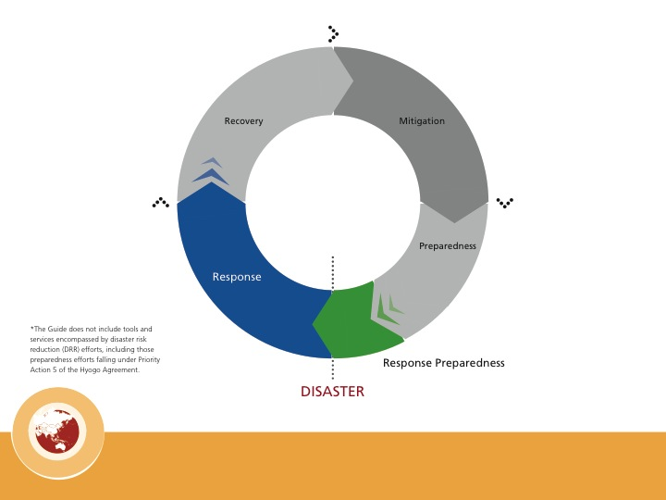
Scope of the Guide: Response & Response Preparedness

Slide 3
Map of sub-regional organizations: ASEAN, SAARC, SPC

Slide 4
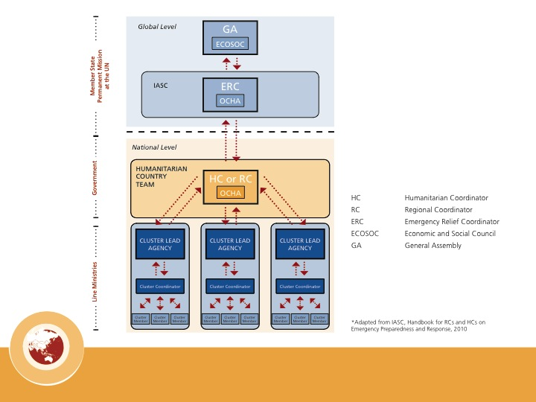
IASC Humanitarian Coordination Architecture

Slide 5
IASC Inter-Agency Standing Committee

Slide 6
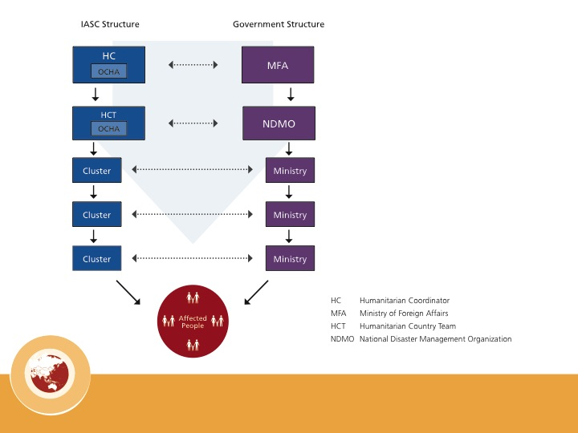
HCT Coordination and Interface with Government

Slide 7
Clusters

Slide 8
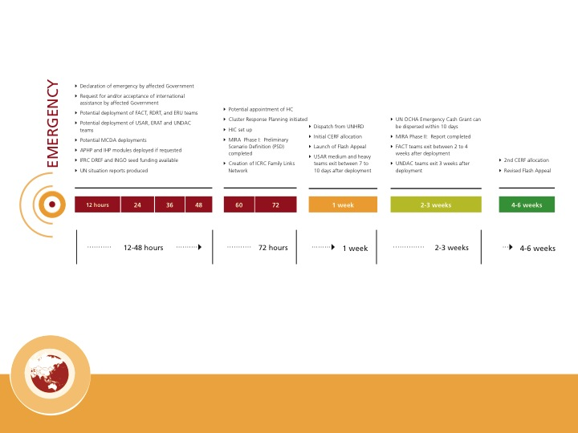
Timeline of disaster response tools and services in medium and large scale emergencies

Slide 9
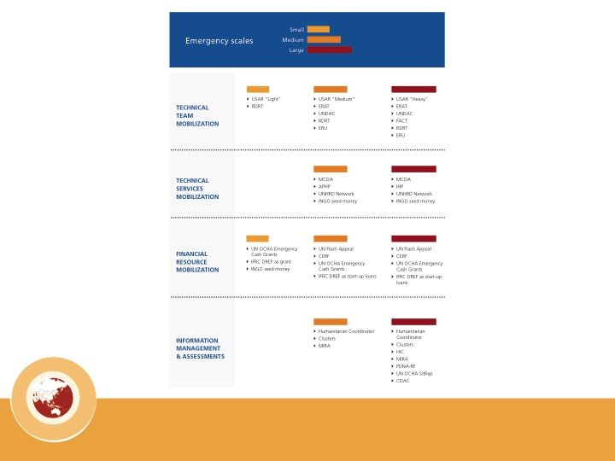
Available tools and services by scale of disaster
(as requested by affected Government)

Slide 10
UNHRD in Subang, Malaysia

Slide 11
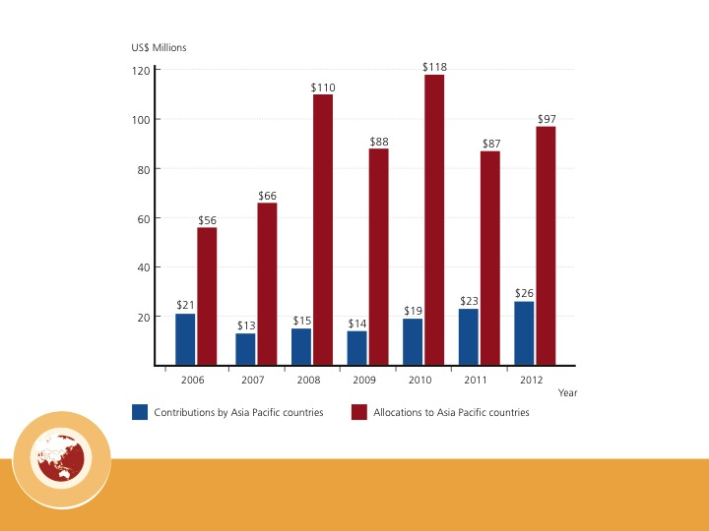
CERF contributions and allocations in Asia and the Pacific 2006-2012

Slide 12
Map of UNDAC Member and Participating States in Asia and the Pacific

Slide 13
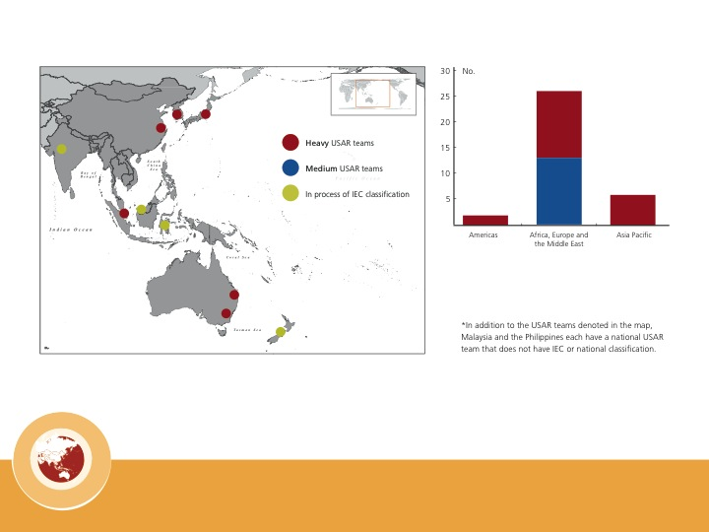
Countries with IEC-classified USAR teams in Asia and the Pacific

